Slide 1
Checking understanding of place value in metric units
Place value

Slide 2
how to use Oak lessons

Slide 3
I can interpret place value in the context of measure (metric).

Slide 4
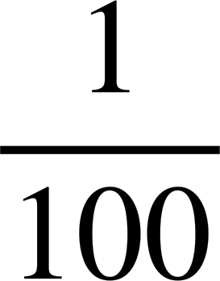
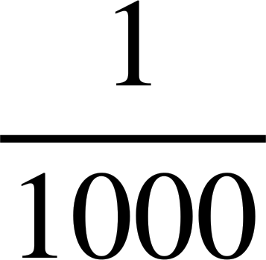
Metric units are based around the standard units of metre, gram and litre.
A prefix is a group of letters attached to the front of a root (word) to make a new word, for example tricycle.
Centi placed before a unit means .
Milli placed before a unit means .
Kilo placed before a unit means 1000 times.

Slide 5

Checking understanding of place value in metric units
Different types of metric units
Prefixes

Slide 6
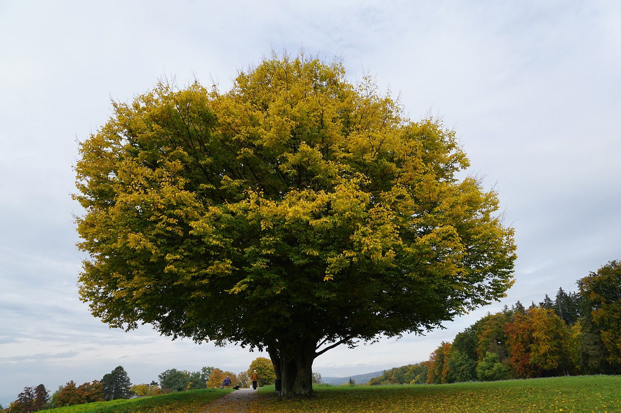

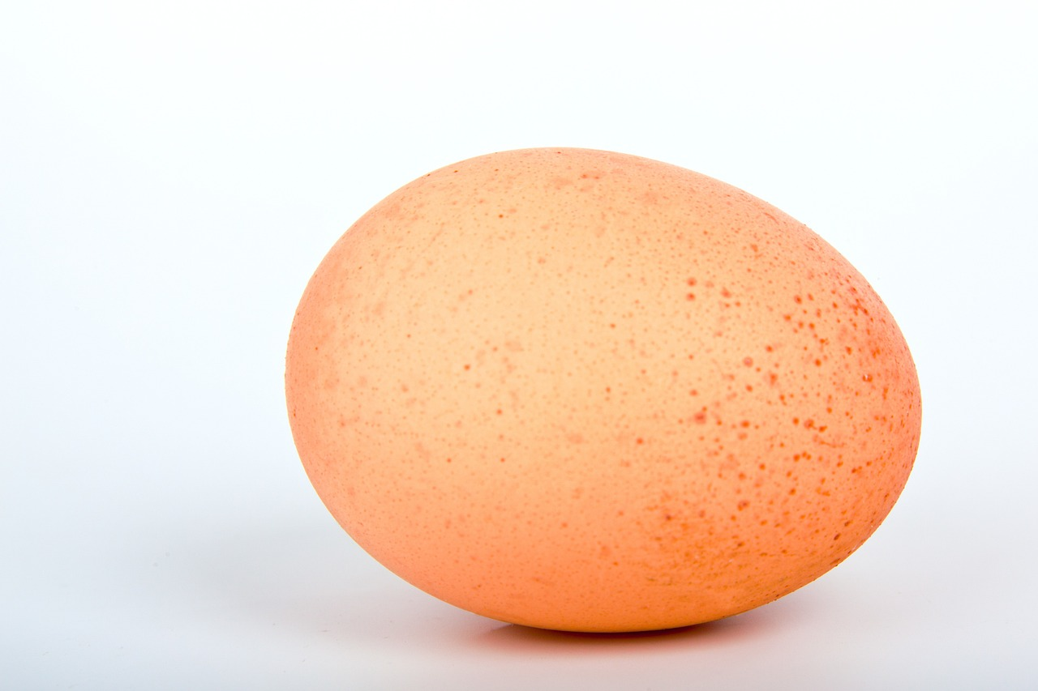
Different types of metric units
The height of the tree.
The capacity of the vase.
What units might we use for each of these?
The mass of the egg.

Slide 7
Different types of metric units
Units give an understanding of what is being measured and its size.
They can be grouped as length, mass or capacity.
Metric units are based around the metre, gram and litre.

Slide 8
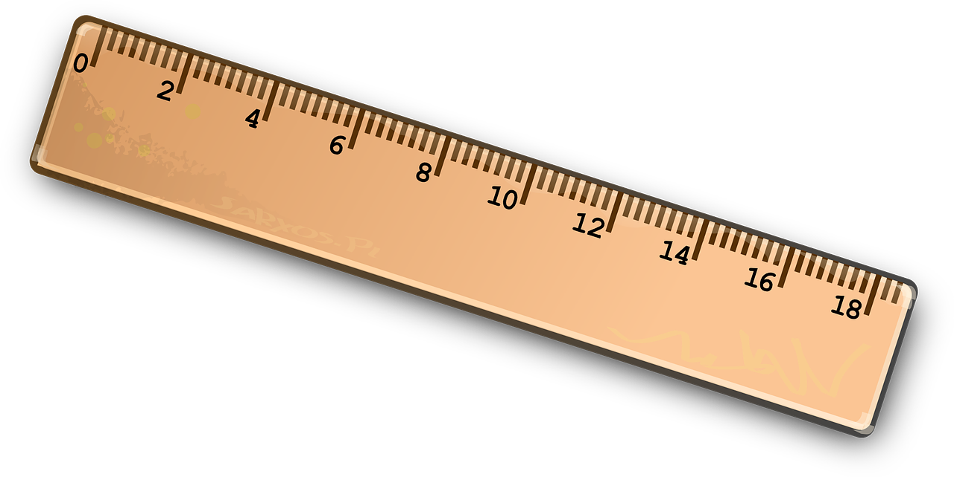
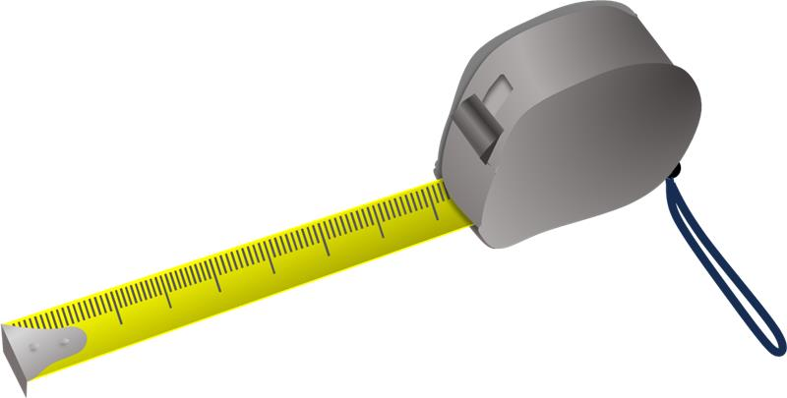
Different types of metric units
Length
kilometre, km
metre, m
centimetre, cm
millimetre, mm

Slide 9
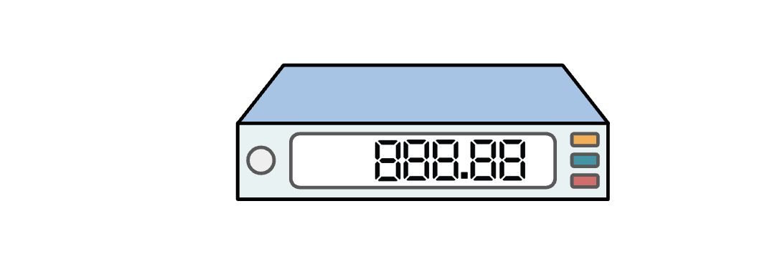
Different types of metric units
Mass
kilogram, kg
gram, g
milligram, mg

Slide 10

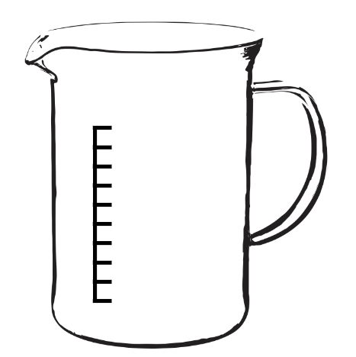
Different types of metric units
Capacity
litres, l
centilitres, cl
millilitres, ml

Slide 11

Different types of metric units
A centimetre is a unit of .
length
capacity
mass

Slide 12
Different types of metric units
A kilogram is a unit of .
length
capacity
mass

Slide 13
Different types of metric units
A type of unit for the distance between two towns would be a unit of length.
A sensible metric unit of length would be kilometres (km).
For example, the direct distance between Edinburgh and Cambridge is 470 kilometres.

Slide 14
Different types of metric units
A type of unit for the amount of liquid a cup can hold would be a unit of capacity.
A sensible metric unit of capacity would be millilitres (ml).
For example, a cup holds approximately 250 millilitres.

Slide 15
Different types of metric units
Sort the given units into the relevant categories.
Length
Mass
Capacity
cm
kg
m
ml
mg
mm
g
cl
km
l

Slide 16
Different types of metric units
For each of the following, write down a sensible metric unit.
The distance between Poole and London is 179 ...
The height of a 3 year old child is 98 ..
The capacity of a kettle is 1.7 ..
The length of a classroom is 6 ..
The mass of an apple is 86 ..
The capacity of a teaspoon is 5 ..

Slide 17
Different types of metric units
Sort the given units into the relevant categories.
Length
Mass
Capacity
cm
km
g
mg
ml
cl
m
kg
l
mm

Slide 18
Different types of metric units
For each of the following, write down a sensible metric unit.
The distance between Poole and London is 179 kilometres (km)
The height of a 3 year old child is 98 centimetres (cm)
The capacity of a kettle is 1.7 litres (l)
The length of a classroom is 6 metres (m)
The mass of an apple is 86 grams (g)
The capacity of a teaspoon is 5 millilitres (ml)

Slide 19
Checking understanding of place value in metric units
Different types of metric units
Prefixes

Slide 20
Prefixes
The metric units are based around the standard units of metre (length), litre (capacity) and gram (mass).
centimetre means of a metre
millimetre means of a metre
kilometre means 1000 metres

Slide 21






Prefixes
1000 | 100 | 10 | metres
 |  | 10 | metres
kilo | hecto | deca | metres | deci | centi | milli
describes greater length
describes smaller length

Slide 22
Prefixes
kilo |  |  | metres |  | centi | milli
 |  |  |  |  | 6
describes greater length
describes smaller length
6 centimetres

Slide 23
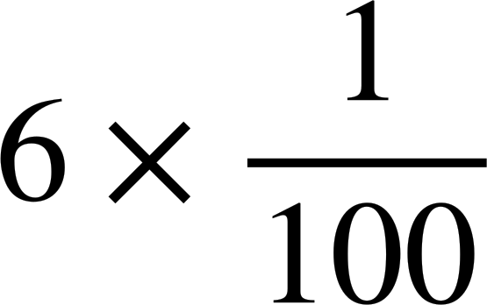
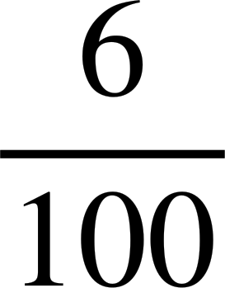
Prefixes
kilo |  |  | metres |  | centi | milli
 |  |  |  |  | 6
describes greater length
describes smaller length
= of a metre
= 6 hundredths of a metre
6 centimetres
= of a metre

Slide 24
Prefixes
kilo |  |  | metres |  | centi | milli
 |  |  |  |  | 6
 |  |  | 0 | 0 | 6
describes greater length
describes smaller length
= of a metre
= 6 hundredths of a metre
6 centimetres
= of a metre
= 0.06 metres

Slide 25
Prefixes
kilo |  |  | metres |  | centi | milli
 |  |  |  |  |  | 8
describes greater length
describes smaller length
8 millimetres

Slide 26
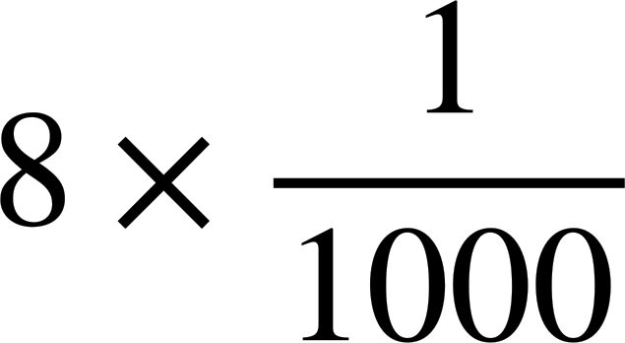
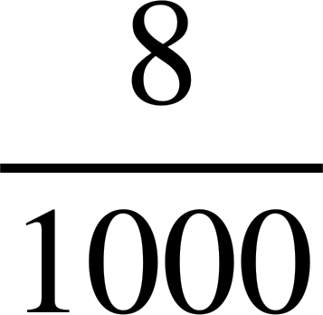
Prefixes
kilo |  |  | metres |  | centi | milli
 |  |  |  |  |  | 8
describes greater length
describes smaller length
= of a metre
= 8 thousandths of a metre
8 millimetres
= of a metre

Slide 27
Prefixes
kilo |  |  | metres |  | centi | milli
 |  |  |  |  |  | 8
 |  |  | 0 | 0 | 0 | 8
describes greater length
describes smaller length
= of a metre
= 8 thousandths of a metre
8 millimetres
= of a metre
= 0.008 metres

Slide 28
Prefixes
1 millimetre is larger than 1 centimetre.
of a metre is less than of a metre.
1000 is greater than 100.

Slide 29
Prefixes
kilo |  |  | grams |  | centi | milli
3
describes greater mass
describes smaller mass
3 kilograms

Slide 30
Prefixes
kilo |  |  | grams |  | centi | milli
3
describes greater mass
describes smaller mass
= 3 × 1000 grams
3 kilograms

Slide 31
Prefixes
kilo |  |  | grams |  | centi | milli
3
3 | 0 | 0 | 0
describes greater mass
describes smaller mass
= 3 × 1000 grams
= 3000 grams
3 kilograms

Slide 32
Prefixes
of a litre would be equivalent to
6 centilitres
6 millilitres
6 centimetres

Slide 33
Prefixes
 |  |  | grams
 |  |  | 0 | 0 | 0 | 3
Describes greater mass
Describes smaller mass
The decimal 0.003 grams is equivalent to 3 milligrams.
The decimal 0.003 grams is equivalent to 3

Slide 34
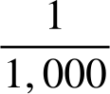
Prefixes
Fill in the appropriate prefixes in the blank boxes.
1000 | 100 | 10 | unit
 |  | 10 | unit
 |  |  | unit

Slide 35
Prefixes
Order the units from smallest to largest.
a) litre, millilitre, centilitre
b) kilometre, millimetre, metre, centimetre
c) milligram, kilogram, gram

Slide 36
Prefixes
Complete the following statements. If in the future a new metric unit is defined and named an ‘acorn’.
a) A would be 100 times smaller than an ‘acorn’.
b) A would be 1000 times larger than an ‘acorn’.

Slide 37
Prefixes
Fill in the appropriate prefixes in the blank boxes.
1000 | 100 | 10 | unit
 |  | 10 | unit
kilo |  |  | unit |  | centi | milli

Slide 38
Prefixes
Order the units from smallest to largest.
a) litre, millilitre, centilitre
b) kilometre, millimetre, metre, centimetre
c) milligram, kilogram, gram
millilitre, centilitre, litre
millimetre, centimetre, metre, kilometre
milligram, gram, kilogram

Slide 39
Prefixes
Complete the following statements.
If in the future a new metric unit is defined and named an ‘acorn’.
a) A centiacorn would be 100 times smaller than an ‘acorn’.
b) A kiloacorn would be 1000 times larger than an ‘acorn’.

Slide 40
Checking understanding of place value in metric units
Depending on the context, a sensible unit can be deduced.
The prefix informs the size compared to the three standard metric units.
The standard metric units are metre, litre and gram.

Slide 41

© Oak National Academy 2023.
Produced in partnership with Mathematics in Education and Industry.
Licensed on the Open Government Licence v3.0, except where otherwise stated. See Oak terms and conditions.

